Slide 1
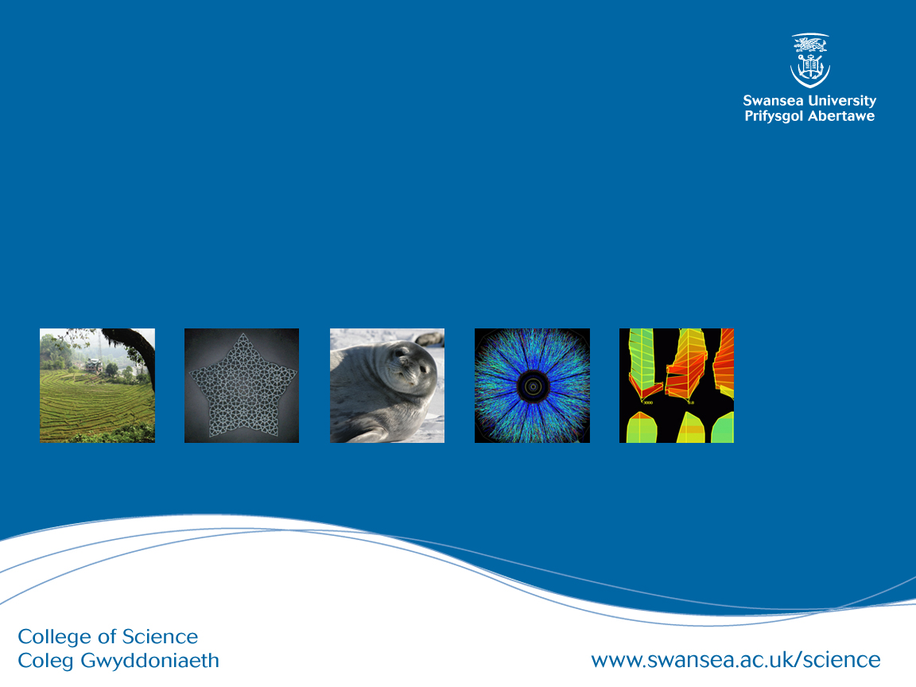
CSC349 User Experience
Practical 3 – Scenarios in Design

Slide 2
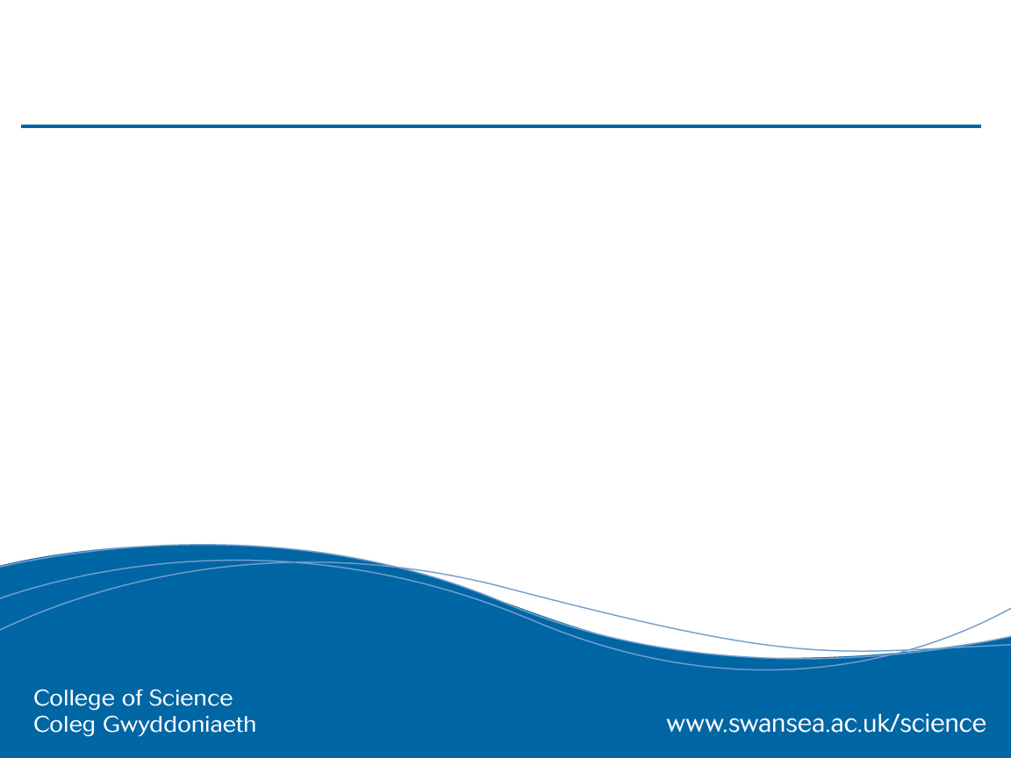
Design challenge 1:
Location-Driven Social Media
Many different types of social media make use of your location data in some way but new advances in location services have not been fully leveraged. For this exercise, sketch 10 novel ways that you might design a social media platform that is fully location aware.
Assumptions
You know peoples location down to the room they are in
You have a critical mass of users available to you

Slide 3
Reminder: Personas Qualities
1. Represent a major user group for your product
2. Express and focus on the major needs and expectations of the most important user groups
3. Give a clear picture of the user's expectations and how they're likely to use the product
4. Aid in uncovering universal features and functionality
5. Describe real people with backgrounds, goals, and values

Slide 4
From a practical perspective, why do you think we really use persona?
How good is this approach to design, how does it compare to other approaches?

Slide 5
The many applications of Scenarios in Design
Scenarios used for capturing data gathered in your scoping or other user engagement sometimes called Requirements Capture in Software engineering:
Scenarios (or Current Scenarios)
Use Cases and Use Case Diagrams
(Hierarchical) Task Analysis
Scenarios that are directly applied to help with the design and envisionment process and benefit from being more “sketchy”
Future Scenarios
Storyboarding
Pastiche Scenarios

Slide 6
(Current) Scenarios
The original application of scenarios in design was by J Carroll and leverages the natural tendency of people to tell stories to explain their work or lives
Scenarios consist of short, textual descriptions of a current common scenario in the space you are designing for
Scenarios can be generated from observation, brainstorming or other user scoping
Scenarios can also be constructed in collaboration with your future users in workshops or focus groups as a form of shared output
Personas can be the actors in a scenario
Notes:
Then what happens? We have a raft of issues to address
three's no clear cut law of emergence vs. convergence

Slide 7
Current Scenarios Example
For a data entry team:
“Well, this is where the admissions forms arrive. We receive about 50 a day during the peak application period. Brian (a persona that represents new staff with some tech savvy but little experience) will open the forms and check that they are complete that is all the documentation has been included. You see we require copies of relevant school exam results and evidence of work experience before we can process the applications. Depending on the results of this, we either pass them on to….”

Slide 8
Use Cases
Use cases focus on user goals and how this can be realised through user-system interaction
Consider this use case for online shopping
Search for items to purchase
Select item to buy
2.1. If Item out of stock then return to step 1
Enter purchase information
Use cases have actors who do something in the system and a set of actions they will take while interacting with the system

Slide 9
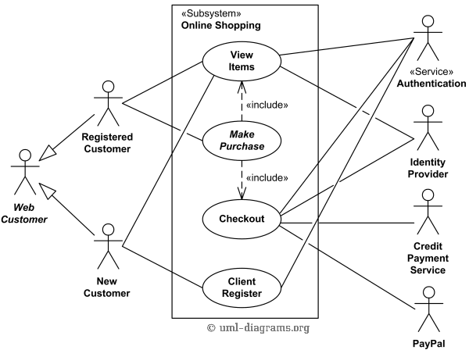
Use Case Diagrams (containing multiple use cases and actors)

Slide 10
Use Case Diagrams and Weaknesses
The Use Case diagram represents all the actors and their use cases in your system so can be considered a more nuanced form of Stakeholder Identification
Also shows the interaction between Use Cases so when more than one actor is involved directly in a Use Case clashes can be caught
Weaknesses of this approach are it’s implicit assumption that there is a system to interact with
How would you capture an interaction where you need to phone up to register to use an online shopping system (common in Business2Business services)

Slide 11
What’s the biggest weakness of Use Cases from our perspective?

Slide 12
Task Analysis
Task Analysis is a structured investigation of how people go about achieving their goals in the real world
There are many forms of Task Analysis but the most common is Hierarchical Task Analysis where steps are broken down into sub-steps
Strengths of Hierarchical Task Analysis are
Allowing an objective comparison of alternative designs
Allowing abstraction in detail for design discussions
Supporting design re-use
Weaknesses
Parallelisation not possible
Doesn’t scale well with complexity
Notes:
Then what happens? We have a raft of issues to address
three's no clear cut law of emergence vs. convergence

Slide 13
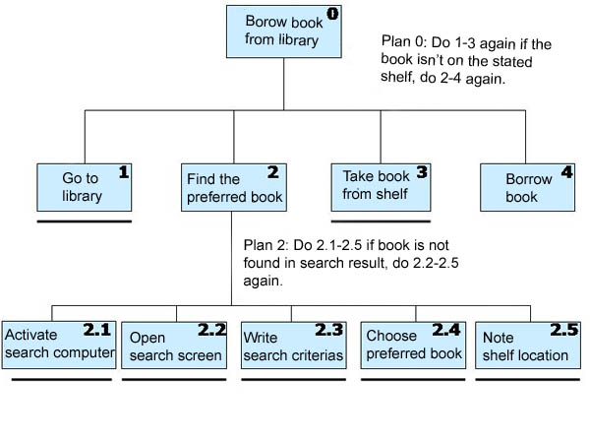

Slide 14
Future Scenarios
A common alternative to the Current Scenario approach that rapidly emerged
Simple, textual descriptions of how a person might interact with a future piece of technology that motivate how you can design and develop the technology
Excellent for placing a strong emphasis on the UX of a product because you tell a story about it
And can focus on negative as well as positive UX to motivate design
Strong crossover with Persona in Future Scenario work

Slide 15
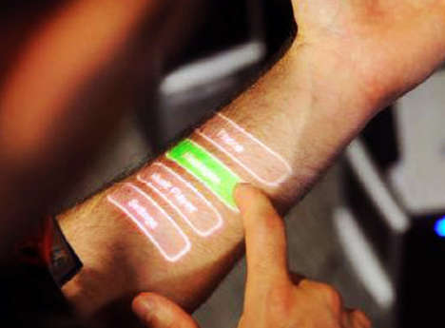
Future Scenarios Example: Skinput
“Neal has just finished his run, he likes listening to music and has been playing his favourite piece. Skinput is great for him, he can focus on running while scrolling through songs. With a flick of his fingers, he turns off the music and opens up the TV remote on his forearm and selects his favourite show. Feeling hungry, he pulls up a list of potential recipes on his arm based off the food currently in his kitchen…”

Slide 16
Design challenge 1:
Location-Driven Social Media
Construct 3 fictional persona who might use your future social media platform breaking them down along key characteristics that you envision.
Construct a future scenario for your social media platform as a group. This should take the form of a short story that shows some of the most interesting elements of the platform. Bring at least one of your personas into the story as you construct it.

Slide 17
Storyboarding
A further, specific refinement to future scenarios in which designers sketch imagined experiences with a design
One of the most prevalent types of design activity, intuitively understood by many people
So far, we have talked about ways to document design concepts and share them with other designers but how do we present our results to end users?
As an approach, storyboarding benefits from being “sketchy” but can also be a technique for presenting a finished design
Ambiguity, rapid production and refinement, openness to change

Slide 18
Storyboarding: Key Qualities
Help to place the focus not just on the design but also on:
The wider context of use – where will this be used, who will be around you, what time of day is it, what are you doing at the same time as this task, etc.
The panels before and after you use the technology are most important ones to focus on
The User Experience with a device becomes prioritised in this approach if done correctly
Capture the good and the bad in a storyboard though branching paths
Storyboards can be a way to share design ideas as well as do design work
Although they should not be both – why?

Slide 19
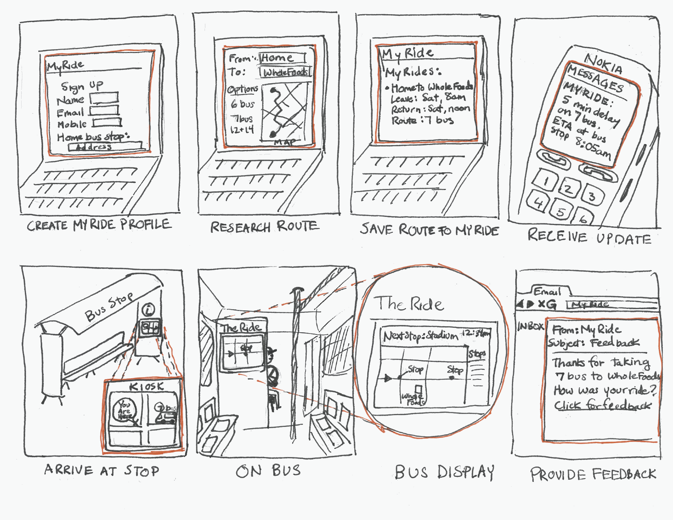

Slide 20
Design challenge 1:
Location-Driven Social Media
Do design work: As a group, build a few examples of storyboards that you can use to illustrate your ideas about the location driven social media platform. Make sure that you capture the key details around what happens before and after people use technology and try to place an emphasis on UX.
Share design work: Once you have done this, devise one storyboard to illustrate your overall concept. Think about how this needs to be different to your sketched storyboards.

Slide 21
A Novel Approach: Pastiche Scenarios
Pastiche Scenarios are short stories about famous, fictional characters using different designs, what does Scrooge McDuck think of online banking, how does Indiana Jones feel about you Google maps rival?
The benefits of the approach include
More relatable, shareable characters and scenarios
Characters that are often imperfect in their use of technology
Drawbacks
You need to have some basic writing ability
Pastiches aren’t always seen as particularly serious
Notes:
Then what happens? We have a raft of issues to address
three's no clear cut law of emergence vs. convergence

Slide 22
‘‘Look around, around, around around round’ Beatles suggest. I do and the landscape doesn’t seem so bleak. For a moment I feel all sixties. Yes, everything is beautiful, even youth in front of me. And of course he’s not a mugger just because he likes baseball caps. Peace, love, yes. Then abrupt stop. Forgotten charge wretched iPod.’’
Notes:
Law – file sharing websites and copyright
Markets – The CD player staayed looong past it’s sell by date because the market wanted it to
Social norm that effects technology – mobile phones in Japan
Architecture – high speed broadband availability and movie streaming
TRAN: Let’s talk about law and law making a little more

Slide 23
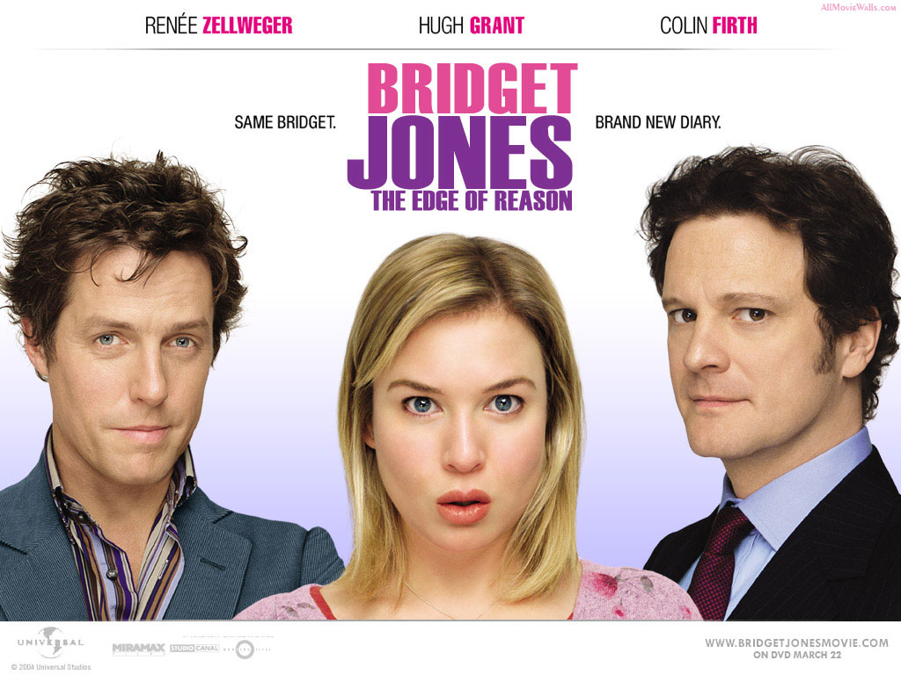
Notes:
Law – file sharing websites and copyright
Markets – The CD player staayed looong past it’s sell by date because the market wanted it to
Social norm that effects technology – mobile phones in Japan
Architecture – high speed broadband availability and movie streaming
TRAN: Let’s talk about law and law making a little more

Slide 24
Design challenge 1:
Location-Driven Social Media
Do design work: As a group, select a few fictional characters and write about how they might feel using your location driven social media platform – ask yourself who you are picking and why you are picking them.
Pay attention to useful larger than life characteristics
Consider how this person compares to your personas in this situation – what is helpful, what is not

Slide 25
Group challenge: Council Services
A local council is having trouble with engaging the people living within it’s boundaries. For example, they struggle to get people to vote at council elections with very low turnout and they have trouble passing basic information on to people like, for example, when their bins are being collected.
Your UX design team have been brought in to brainstorm some solutions to this problem and present them to the council leaders. Be aware that these are not very technically-minded or design-minded people so you will need to present your ideas to them very carefully.

Slide 26
Group challenge
You will be working your groups of 6-8 for this task.
I would recommend starting out by sketching out designs individually like you did in the first exercise but where do you go from there?
Pass the idea
Dividing the dollar?
Card sorting?
Why?
Key challenge – how are you going to present your ideas at the end of the session?

